Slide 1
专业外语
软件工程 物联网
2023

Slide 2
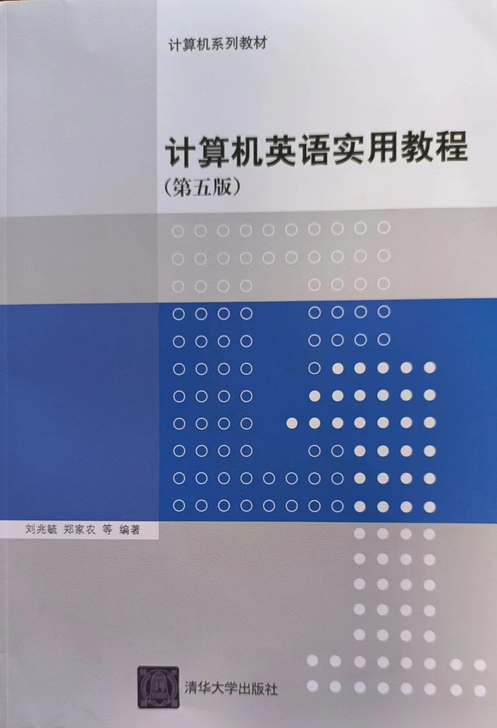
教材

Slide 3
PART 1 COMPUTER ARCHITETURE AND COMPUTER NETWORK CHAPTER 1 COMPUTER ORGANIZATION AND UNITS

Slide 4
1.1 COMPUTER ORGANIZATION

Slide 5
architecture
programmable
input
output
store, storage
bar-code
scanner
joystick
touch screen
digital camera
electronic pen
fingerprint reader

Slide 6
display screen
desktop printer
online
workstation
magnetic tape drive
primarily storage
secondary storage
supercomputer
mainframe computer
midrange computer

Slide 7
KEYWORDS
architecture 体系结构,结构,层次结构,总体结构,结构格式
programmable 可编程的
input 输入
output 输出
store, storage 存储,存储器
bar-code 条形码
scanner 扫描仪
joystick 操纵杆
touch screen 触摸屏
digital camera 数码相机
electronic pen 电子笔
fingerprint reader 指纹阅读器

Slide 8
stereo system 立体音响系统
CD(Compact Disk) 高密度磁盘，光盘，激光唱盘
player 播放器
CPU (Central Processing Unit) 中央处理器
main box 主机箱
control unit 控制器，控制部件
(ALU) arithmetic and logic unit 算术／逻辑部件
register 寄存器
memory 存储器
decode 译码
operand 操作数
communication 通信
machine-coded 机器编码

Slide 9
display screen 显示屏
desktop printer 台式打印机
online 在线，联机
workstation 工作站
magnetic tape drive 磁带驱动器
primarily storage 主存储器
secondary storage 二级存储器
supercomputer 超级计算机
mainframe computer 大型计算机
midrange computer 中型计算机

Slide 10
server 服务器
microcomputer 微型计算机
desktop computer 台式计算机
portable 便携的，手提的，可移植的
screen 屏幕
keyboard 键盘
notebook computer 笔记本电脑
tablet PC 平板式个人电脑
handheld computer 手持计算机

Slide 11
retrieve 检索，使恢复
database 数据库
access 访问，存取，接入，进入
input device 输入设备
output device 输出设备
PDA(Personal Digital Assistants) 个人数字助理
smartphone 智能电话
cell phone 蜂窝电话，移动电话，手机
wireless 无线（的）

Slide 12
1. Computer Organization
A computer is a programming, electronic device that accepts input, performs operations or processing on the data, and outputs and stores the results.
Because it is programmable, the instructions—called the program—tell the computer what to do.
The relationships between these four main computer operations (input, processing, output, and storage) are shown in Figure 1-1.

Slide 13
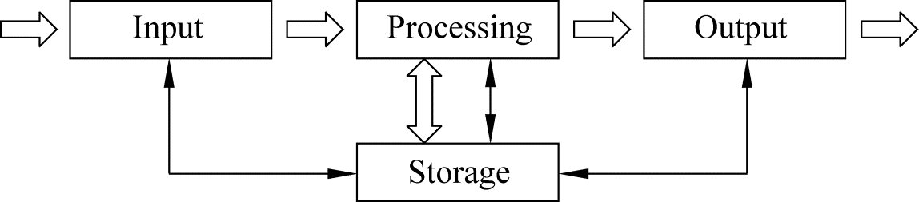
The corresponding devices to perform these tasks are input devices, processing devices, output devices, and storage devices.
Figure 1-1 Basic operations within a computer

Slide 14
（1）Input Devices
An input device is any piece of equipment that supplies materials (input) to the computer.
The most common input devices are the keyboard and mouse (see Figure 1-2).
Other possibilities include image and bar-code scanners, joysticks, touch screens, digital cameras, electronic pens, fingerprint readers, and microphones. Input devices for a stereo system might be a CD player and antenna.

Slide 15
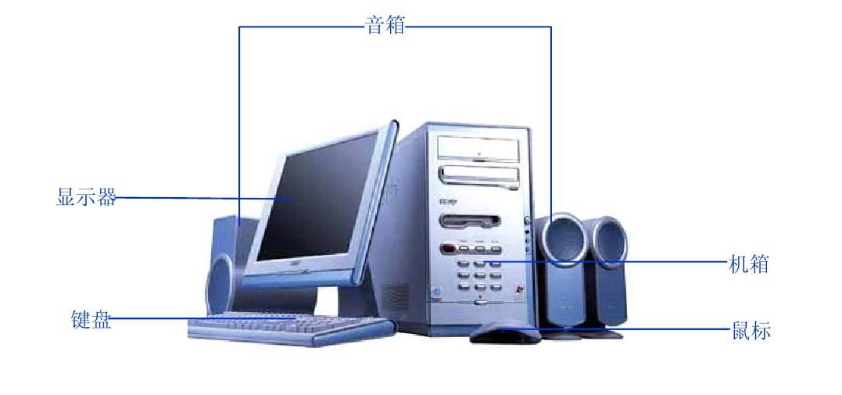
From the Internet
Figure 1-2 Hardware of a computer system

Slide 16
（2）Processing Unit
The heart of any computer system is the central processing unit (CPU), located inside the computer’s main box or system unit.
A processor is composed of two functional units—a control unit and an arithmetic/logic unit—and a set of special workspaces called registers.
Figure 1-3 depicts its structure, in which the Internal CPU Interconnection provides communication among the Control Unit, ALU, and Registers.

Slide 17
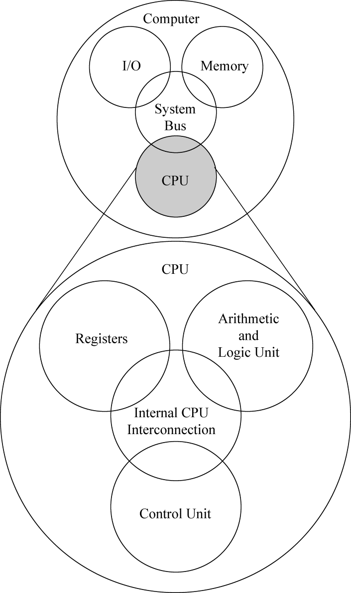
Figure 1-3 Central Processing Unit (CPU)

Slide 18
The control unit is the functional unit that is responsible for supervising the operation of the entire computer system.
The control unit fetches instructions from memory and determines their types or decodes them.
It then breaks each instruction into a series of simple small steps or actions.
By doing this, it controls the step-by-step operation of the entire computer system.

Slide 19
The arithmetic and logic unit (ALU) is the functional unit that provides the computer with logical and computational capabilities.
Data are brought into the ALU by the control unit, and the ALU performs whatever arithmetic or logic operations are required to help carry out the instruction.
A register is a storage location inside the processor.
Registers in the control unit are used to keep track of the overall status of the program that is running.

Slide 20
Control unit registers store information such as the current instruction, the location of the next instruction to be executed, and the operands of the instruction.
In the ALU, registers store data items that are added, subtracted, multiplied, divided, and compared.
Other registers store the results of arithmetic and logic operations.

Slide 21
（3）Output Devices
Like input units, output devices are instruments of interpretation and communication between humans and computer systems of all sizes.
These devices take output results from the CPU in machine-coded form and convert them into a form that can be used (a) by people (e.g. a printed and/or displayed report) or (b) as machine input in another processing cycle.

Slide 22
In personal computer systems, display screen and desktop printers are popular output devices.
Larger and faster printers, many online workstations, and magnetic tape drives are commonly found in larger systems.

Slide 23
（4）Storage Devices
Storage is a computer section used primarily for storing information such as instructions, programs and data.
There are two types in storage devices, one is the memory (sometimes called as primary storage), another is the secondary storage.
Primary storage is located within the system unit that houses the CPU and other components.
Secondary storages include the storage media and drives, We will describe them in section 1-4 of this textbook.

Slide 24
An arbitrary desktop computer (not necessarily a PC) is shown in Figure 1-4.
It has a large main memory to hold the operating system, applications and data, and an interface to mass storage devices(disks and DVD/CD-ROMs).

Slide 25
It has a variety of I/O devices for user input (keyboard, mouse, and audio), user output (display interface and audio), and connectivity (networking and peripherals).
The fast processor requires a system manager to monitor its core temperature and supply voltages, and to generate a system reset.

Slide 26
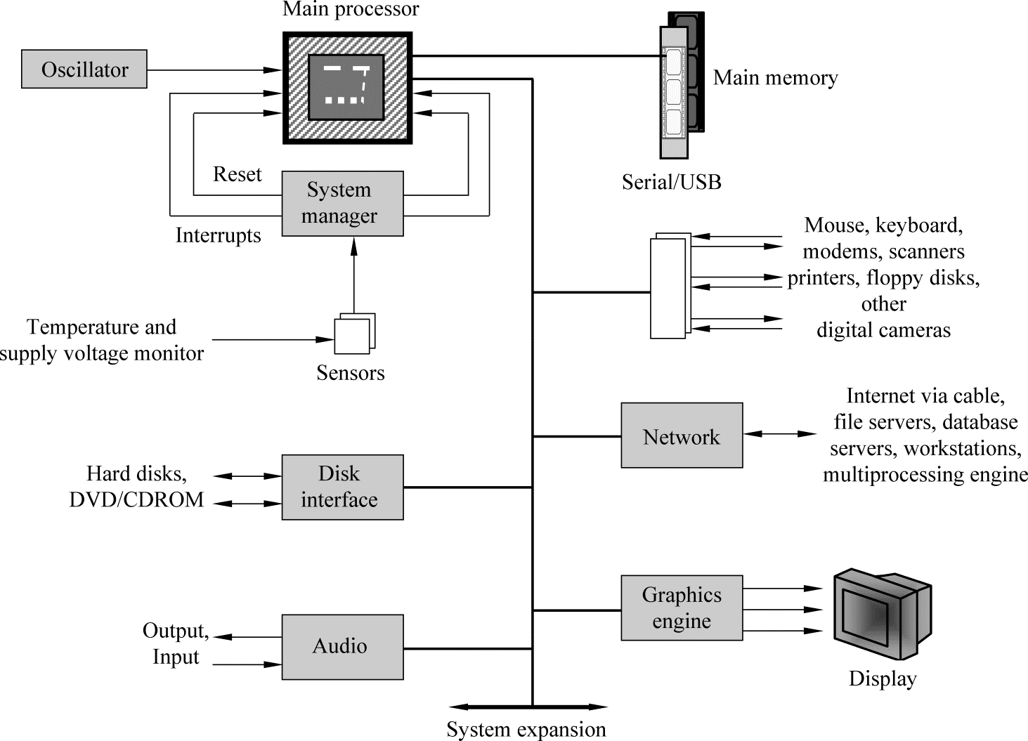
Figure 1-4 Block diagram of a generic computer

Slide 27
2. Types of Computer
There are four types of computers: supercomputers, mainframe computers, midrangecomputers, and microcomputers.
（1）Supercomputers are the most powerful type of computer.
These machines are special high-capacity computers used by very large organizations.
IBM’s Blue Gene is considered by many to be the fastest computer in the world.

Slide 28
（2）Mainframe computers occupy specially wired, air-conditioned rooms.
Although not nearly as powerful as supercomputers, mainframe computers are capable of great processing speeds and data storage.
For example, insurance companies use mainframes to process information about millions of policyholders.

Slide 29
（3）Midrange computers, also referred to as servers, are computers with processing capabilities less powerful than a mainframe computer yet more powerful than a microcomputer.
Originally used by medium-size companies or departments of large companies to support their processing needs, today midrange computers are most widely used to support or serve end users for such specific needs as retrieving data from a database or supplying access to application software.

Slide 30
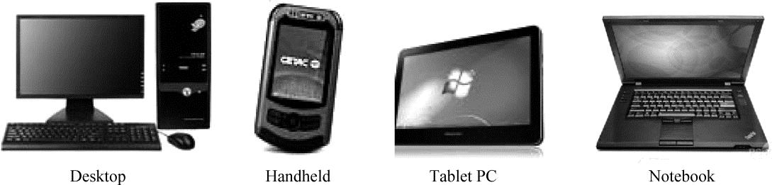
（4）Microcomputers are the least powerful, yet the most widely used and fastest- growing, type of computer.
There are four types of microcomputers: desktop, notebook, tablet and handheld computers. (See Figure 1-5.)
Desktop computers are small enough to fit on top of or alongside a desk yet are too big to carry around.
Notebook computers, also known as laptop computers, are portable and lightweight and fit into most briefcases.
Figure 1-5 Microcomputers

Slide 31
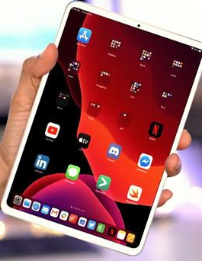
Tablets, also known as tablet computers, are the newest type of computer.
They are smaller, lighter, and generally less powerful than notebook. Like a notebook, tablets have a flat screen but typically do not have a standard keyboard. Instead tablets typically use a virtual keyboard that appears on the screen and is touch-sensitive.
The best known tablet is Apple’s iPad.

Slide 32
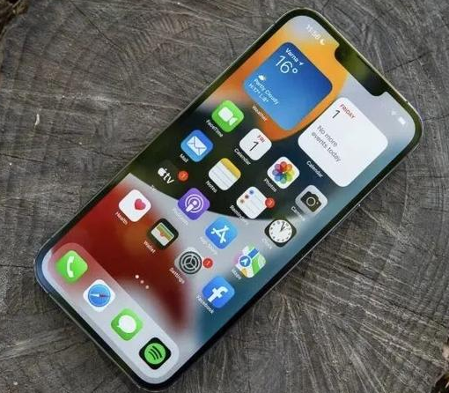
Handheld computers are the smallest and are designed to fit into the palm of one hand.
These systems contain an entire computer system, including the electronic components, secondary storage, and input and output devices.
Personal digital Assistants (PDAs) and smartphones are the most widely used handheld computers.
Smartphones are cell phones with wireless connections to the Internet.
Their growth has been explosive in the past few years.

Slide 33
1.2 MICROPROCESSOR AND SYSTEM BOARD

Slide 34
KEYWORDS
microprocessor 微处理器
chip 芯片
system board 系统板
carrier package 承载插件
cartridge 盒
slot （插）槽
capacity 容量，能力
word sizes 字长，字尺寸
bit 比特，二进制位
byte 字节

Slide 35
microsecond 微秒
nanosecond 毫微秒，纳秒
picosecond 微微秒，皮秒
core 核,核心，芯子
parallel processing 并行处理
die 电路小片，模片，饼图
DSP(Digital Signal Processing) 数字信号处理
embedded 嵌入式的
motherboard 主板，母板
integrated circuit 集成电路
data path 数据通路（路径）
socket 插座，套接字，网络应用程序接口

Slide 36
1. Microprocessors
In a microcomputer system, the central processing unit (CPU) or processor is contained on a single chip called the microprocessor. The microprocessor is either mounted onto a carrier package that plugs into the system board or contained within a cartridge that plugs into a special slot on the system board. (See Figure1-6)
The microprocessor is the “brains” of the computer system.
It has two basic components: the control unit and the arithmetic-logic unit.
Functions of these two units have been mentioned in section 1.1 of this textbook.

Slide 37
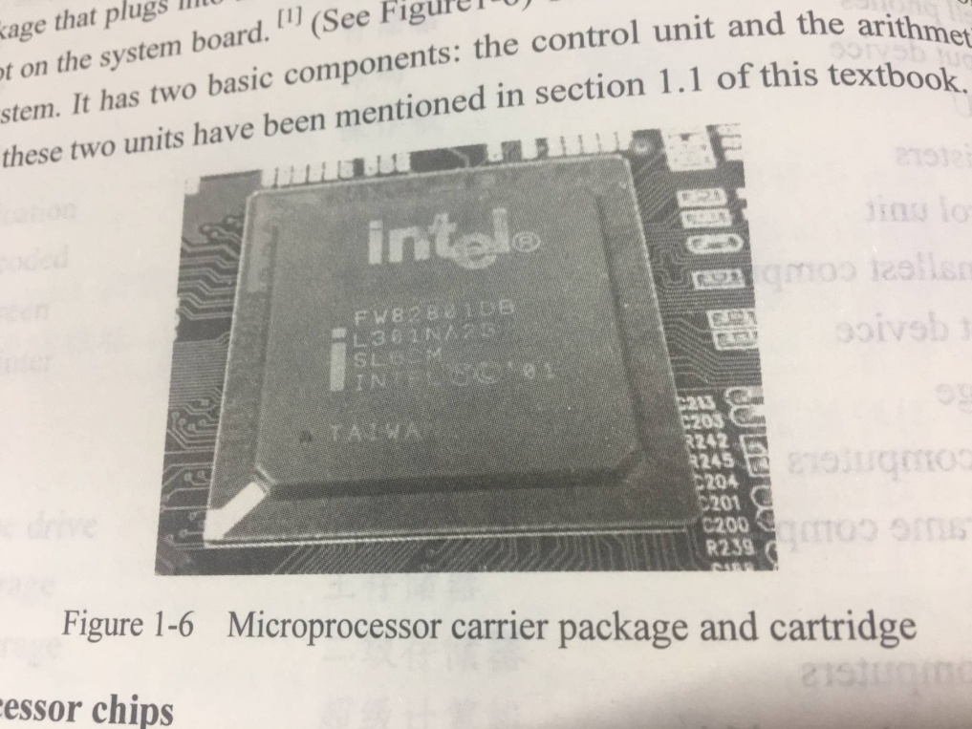
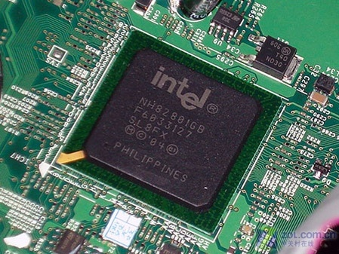
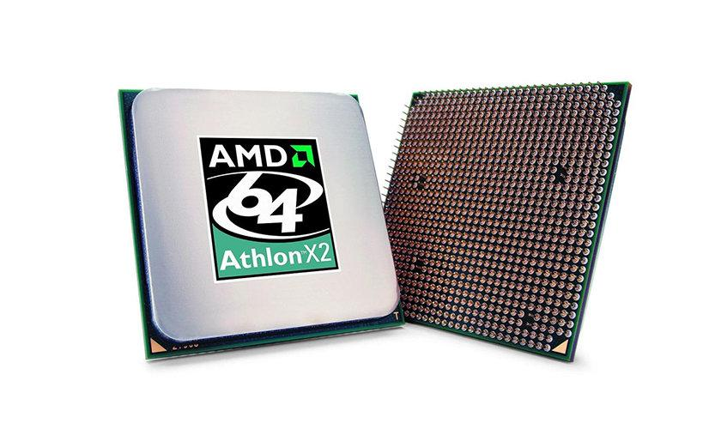
From the Internet
Figure 1-6 Microprocessor carrier package and cartridge
From the Internet

Slide 38
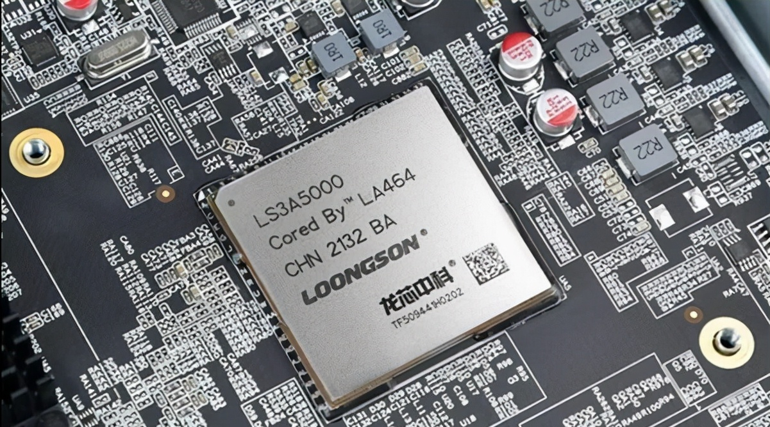
From the Internet

Slide 39
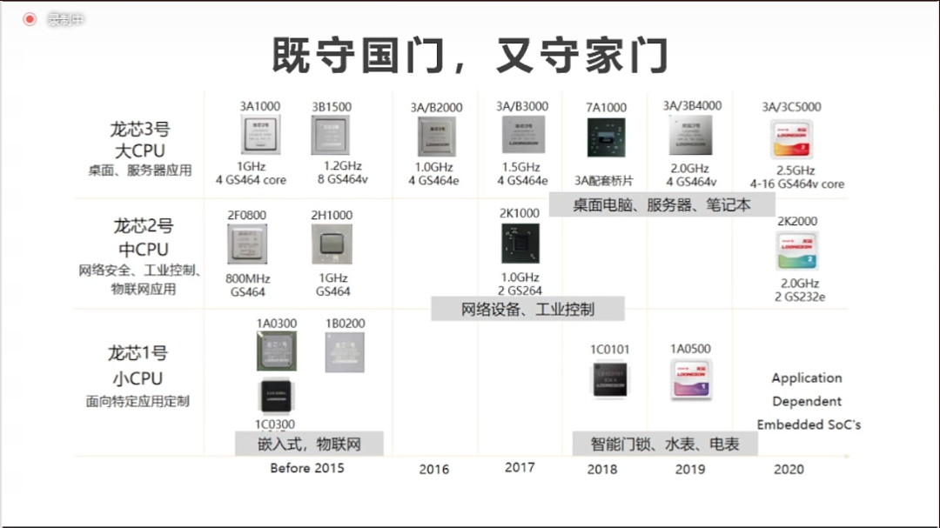

Slide 40
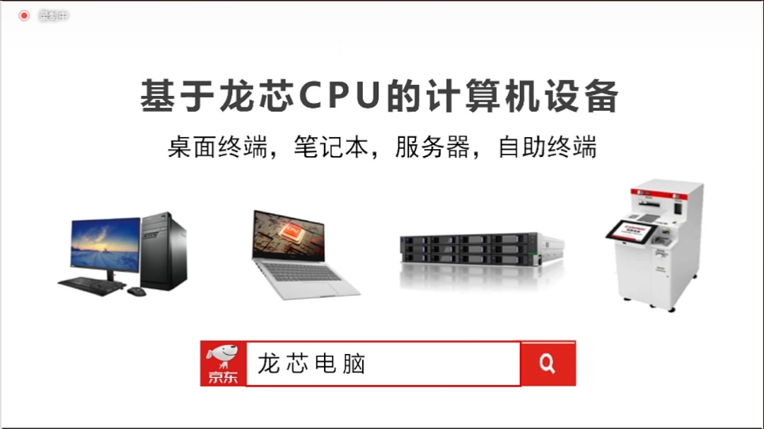

Slide 41
2. Microprocessor chips
Chip capacities are often expressed in word sizes. A word is the number of bits (such as 16, 32, or 64) that can be accessed at one time by the CPU.
The more bits in a word, the more powerful—and the faster—the computer is.
As mentioned previously, eight bits group together to form a byte.
A 32-bit-word computer can access 4 bytes at a time.
A 64-bit-word computer can access 8 bytes at a time.
Therefore, the computer designed to process 64-bit words is faster.

Slide 42
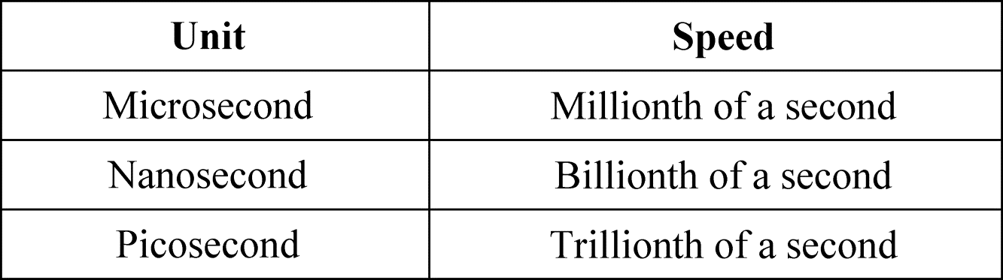
Older microcomputers typically process data and instructions in millionths of a second or microseconds.
Newer microcomputers are much faster and process data and instructions in billionths of a second, or nanoseconds.
Supercomputers, by contrast, operate at speeds measured in picoseconds—1000 times as fast as microcomputers. (See Figure1-7)
Figure 1-7 Processing speeds

Slide 43
The two most significant recent developments in microprocessors are the 64-bit processor and the dual-core chip.
Until recently, 64-bit processors were only used in large mainframe and supercomputers.
All of that is changing as 64-bit processors are becoming commonplace in today’s more powerful microcomputers.

Slide 44
A new type of chip, the dual-core chip, can provide two separate and independent CPUs.
These chips allow a single computer to run two programs at the same time.
For example, access could be searching a large database while the end user is creating a multimedia presentation with PowerPoint.

Slide 45
More significantly, however, is the potential for microcomputers to run very large complex programs that previously were run only on mainframe and supercomputers.
This requires specifically designed programs that are divided into parts that each CPU could process independently.
This approach is called parallel processing.

Slide 46
3. Multi-core processor
A multi-core processor is a single computing component with two or more independent actual central processing units (called “cores”).
Figure 1-8 shows a diagram of a generic dual-core processor.

Slide 47
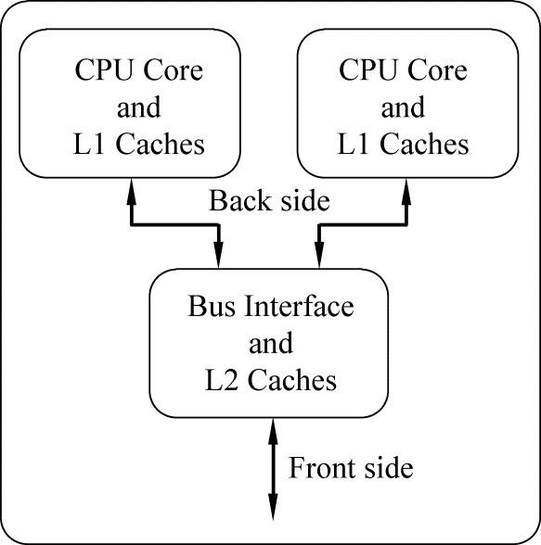
Figure 1-8 A diagram of a generic dual-core processor, with CPU-local
level 1 caches, and a shared, on-die level 2 cache

Slide 48
Manufacturers typically integrate the cores onto a single integrated circuit die (known as a chip multiprocessor or CMP), or onto multiple dies in a single chip package.
Multicore processors may have two cores (dual-core CPUs, for example AMD Phenom II X2 and Intel Core Duo), four cores (quad-core CPUs, for example Intel’s i7 processors), six cores, eight cores, or more.

Slide 49
Multi-core processors are widely used across many application domains including general-purpose, embedded, network, digital signal processing (DSP), and graphics.
Commercially, Adapteva Epiphany, a many-core processor architecture which allows up to 4096 processors on-chip, although only a 16 core version has been commercially produced.

Slide 50
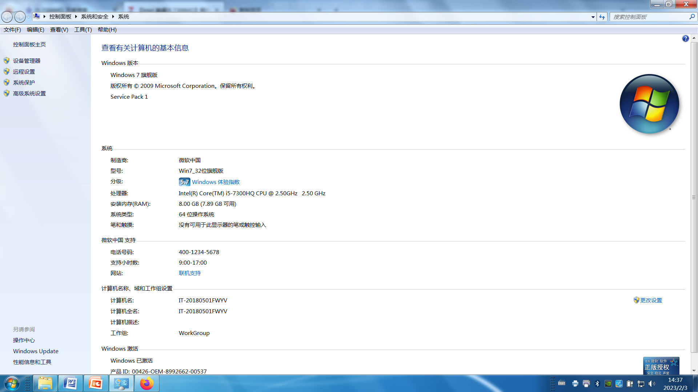
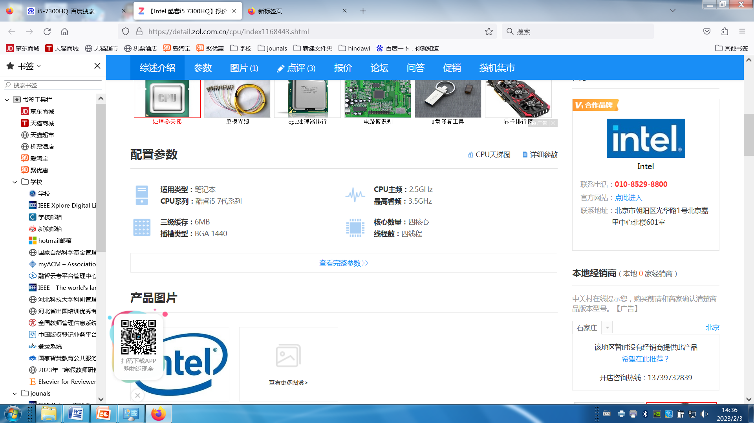

Slide 51
4. System board
The system board is also known as the motherboard.
The system board is the communications medium for the entire computer system.
Every component of the system unit connects to the system board.
It acts as a data path allowing the various components to communicate with one another.
External devices such as the keyboard, mouse, and monitor could not communicate with the system unit without the system board.

Slide 52
On a desktop computer, the system board is located at the bottom of the system unit or along one side.
It is a large flat circuit board covered with a variety of different electronic components including sockets, slots, and bus lines (See Figure 1-9).

Slide 53
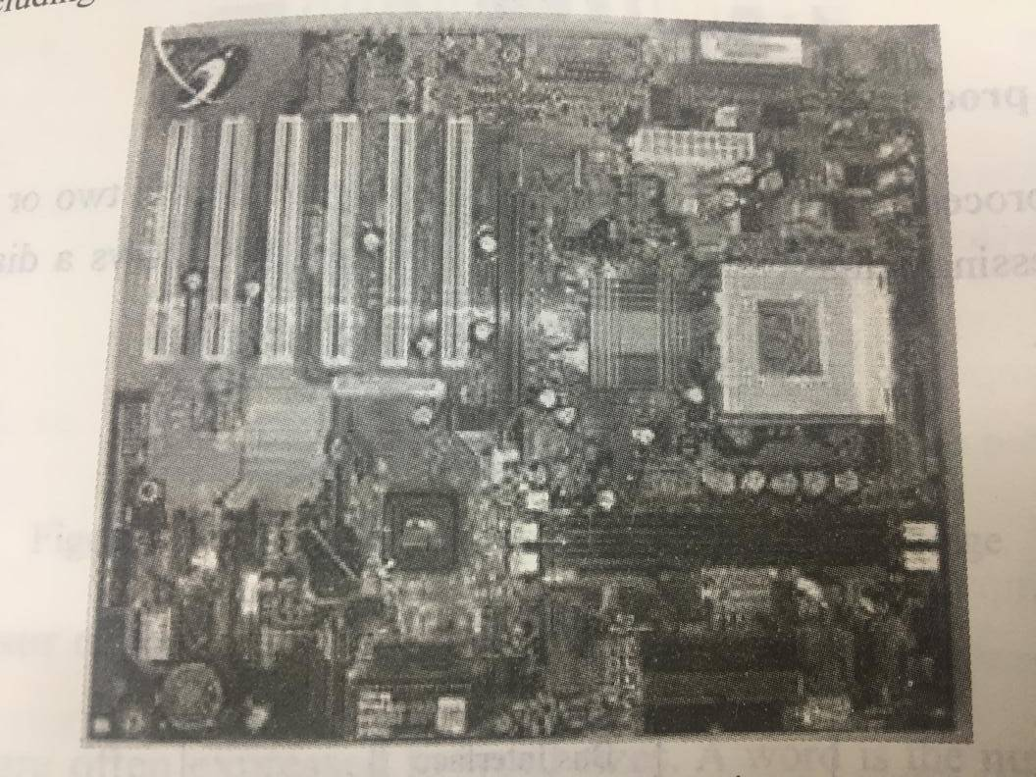
Figure 1-9 System board

Slide 54
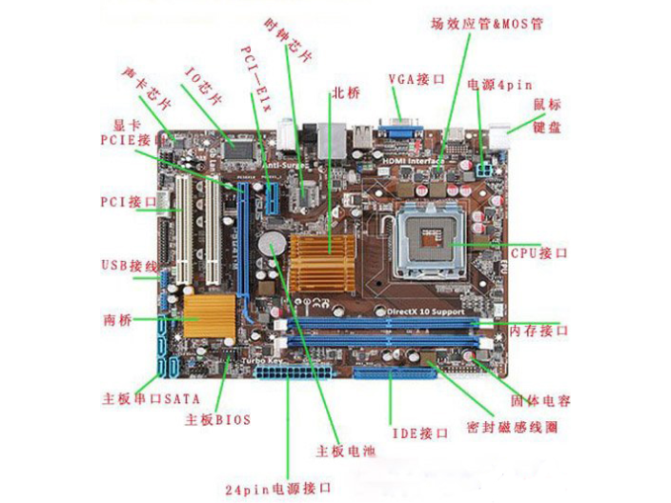
From the Internet

Slide 55
(1) Sockets provide a connection point for small specialized electronic parts called chips.
Chips consist of tiny circuit boards etched onto squares of sandlike material called silicon.
These circuit boards can be smaller than the tip of your finger.
A chip is also called a silicon chip, semiconductor, or integrated circuit.
Chips are mounted on carrier packages. (See Figure 1-10.)

Slide 56
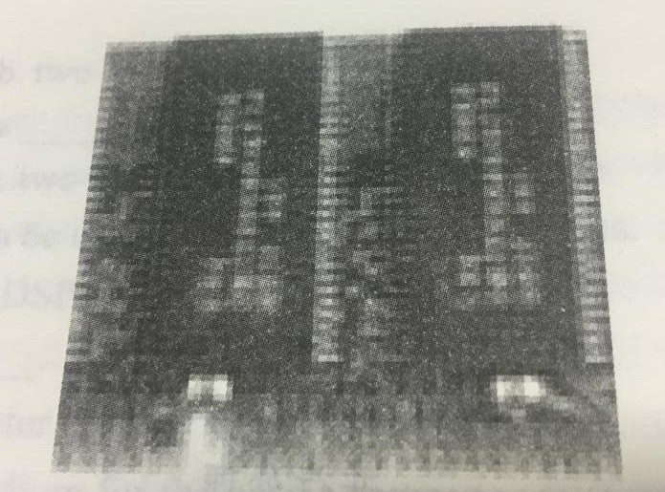
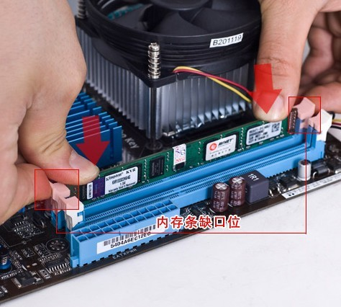
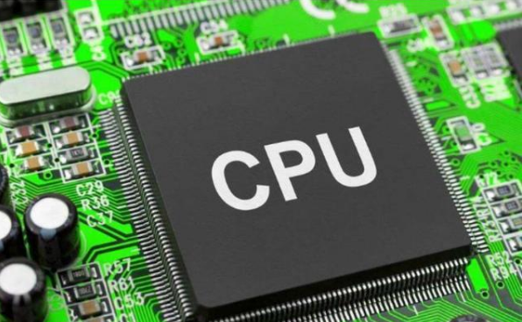
Figure 1-10 Chips mounted onto a carrier package
From the Internet

Slide 57
These packages either plug directly into sockets on the system board or onto cards that are then plugged into slots on the system board.
Sockets are used to connect the system board to a variety of different types of chips, including microprocessor and memory chips.

Slide 58
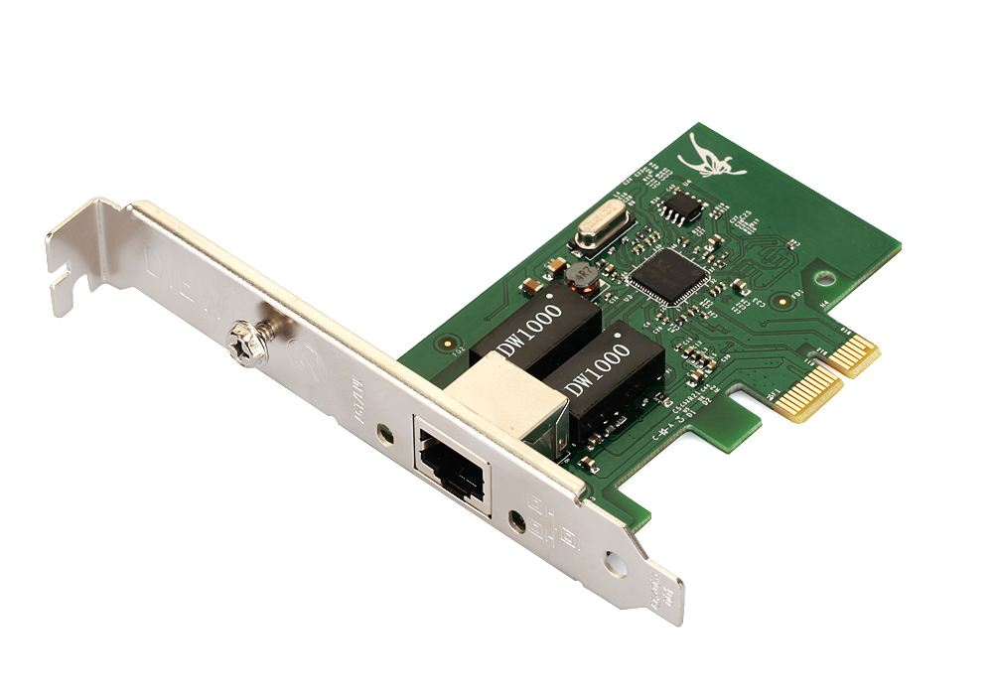
(2) Slots provide a connection point for specialized cards or circuit boards.
These cards provide expansion capability for a computer system.
For example, a modem card plugs into a slot on the system board to provide a connection to the Internet.
网卡
From the Internet

Slide 59
(3) Connecting lines called bus lines provide pathways that support communication among the various electronic components that are either located on the system board or attached to the system board.
Notebook, tablet PC, and handheld system boards are smaller than desktop system boards.
However, they perform the same functions as desktop system boards.

Slide 60
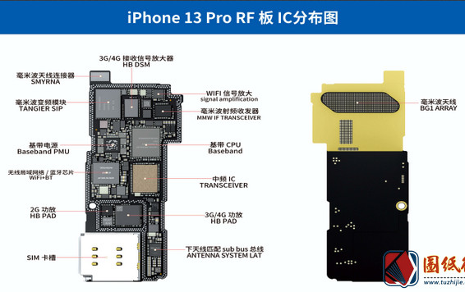
From the Internet

Slide 61
The End of this Section

